Slide 1



PEILab Group Meeting
Leader: Zicong Hong
Team Member: Jian Lin, Haodong Wang, Qianli Liu, Kaibin Guo, Junjie Liu

Slide 2

Star Attention
ICML’25

Slide 3
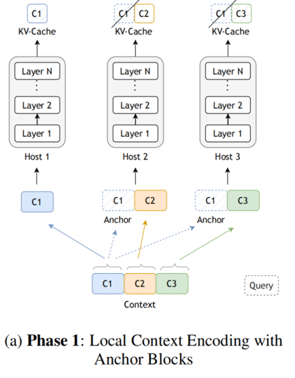


Star Attention

Slide 4
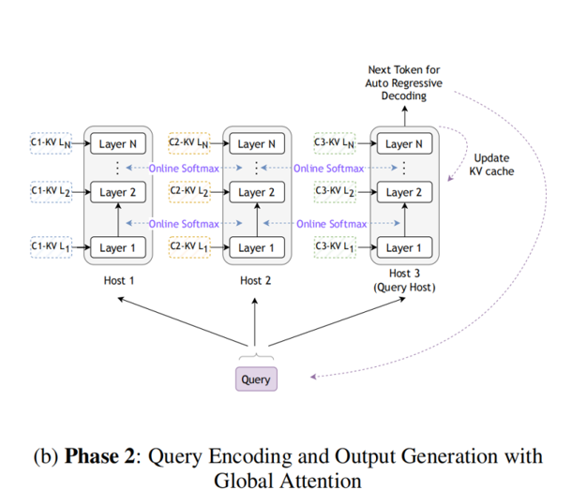


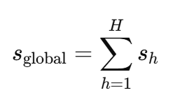
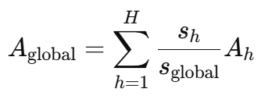
Star Attention
① 局部注意力（Local Attention）计算：
②全局 softmax 归一化：

Slide 5
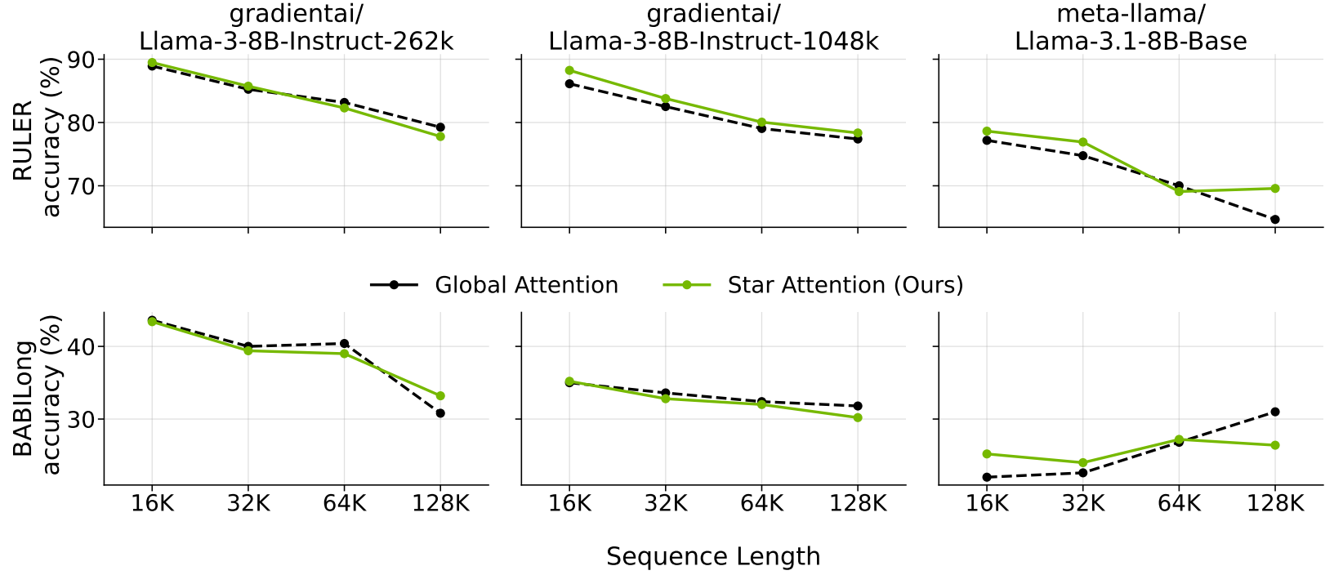

Star Attention

Slide 6
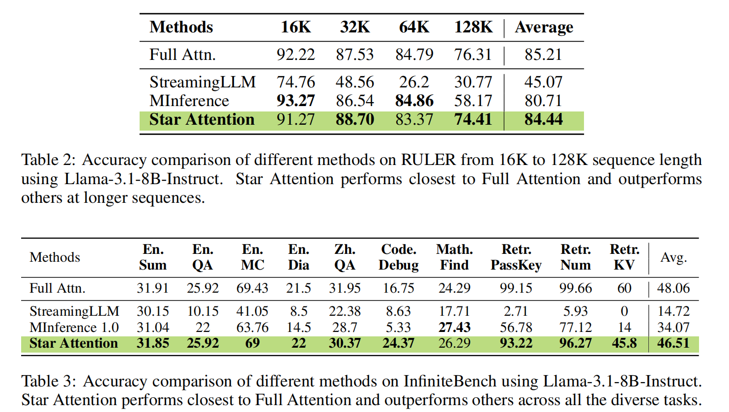
Star Attention

Slide 7
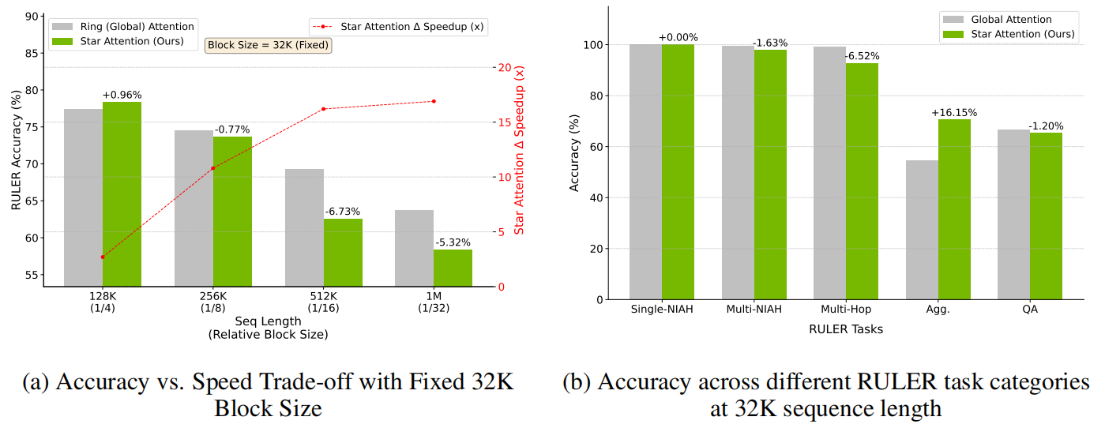
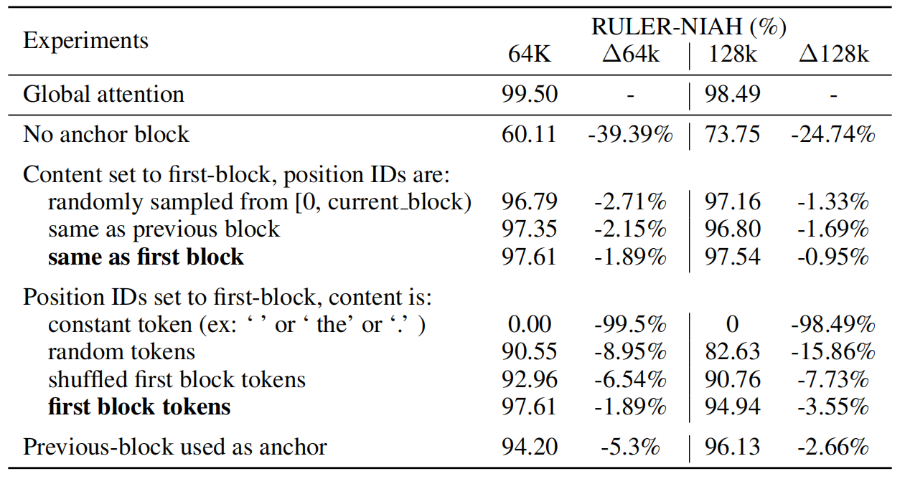
Star Attention

